Slide 1

Demonstrate Resource pooling using AWS S3 cloud storage Section – B
Group no – 6 Vanshika, Siddhartha Urvashi, Rashmita

Slide 2
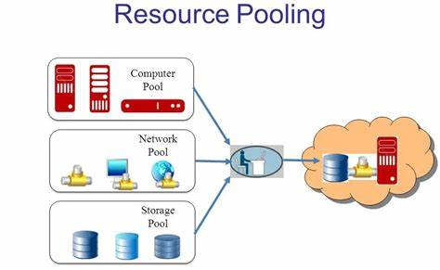
Use AWS S3 or Google Cloud Storage to upload and manage a set of files.
Show how resources are pooled across multiple users.
Resource pooling is used to describe a service provider as providing IT service to multiple customers at a time. And these services are scalable and accessible to businesses as well.
In simple terms Resource pooling is a concept in which resources are shared among multiple clients.

Slide 3
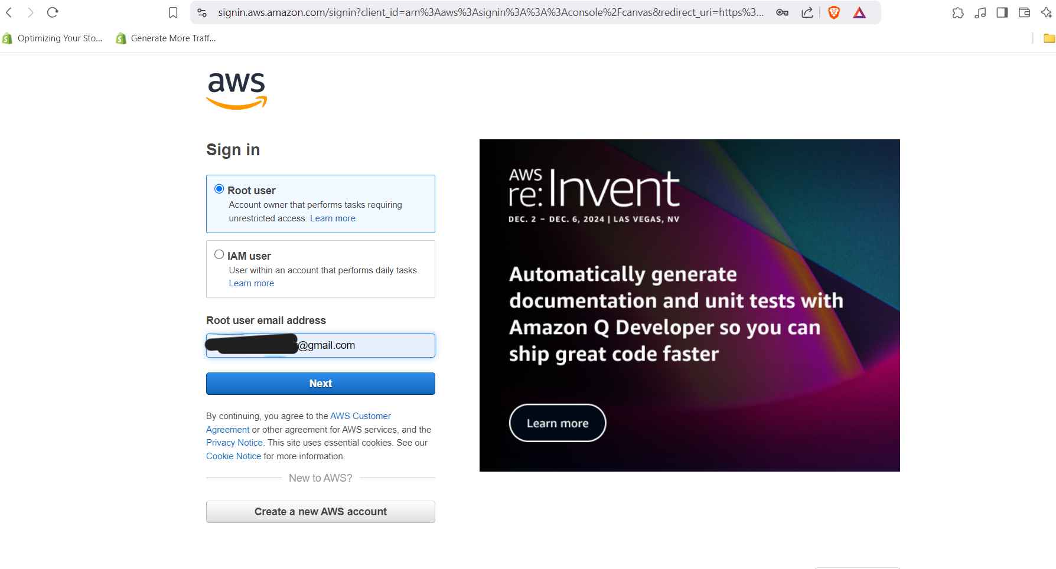
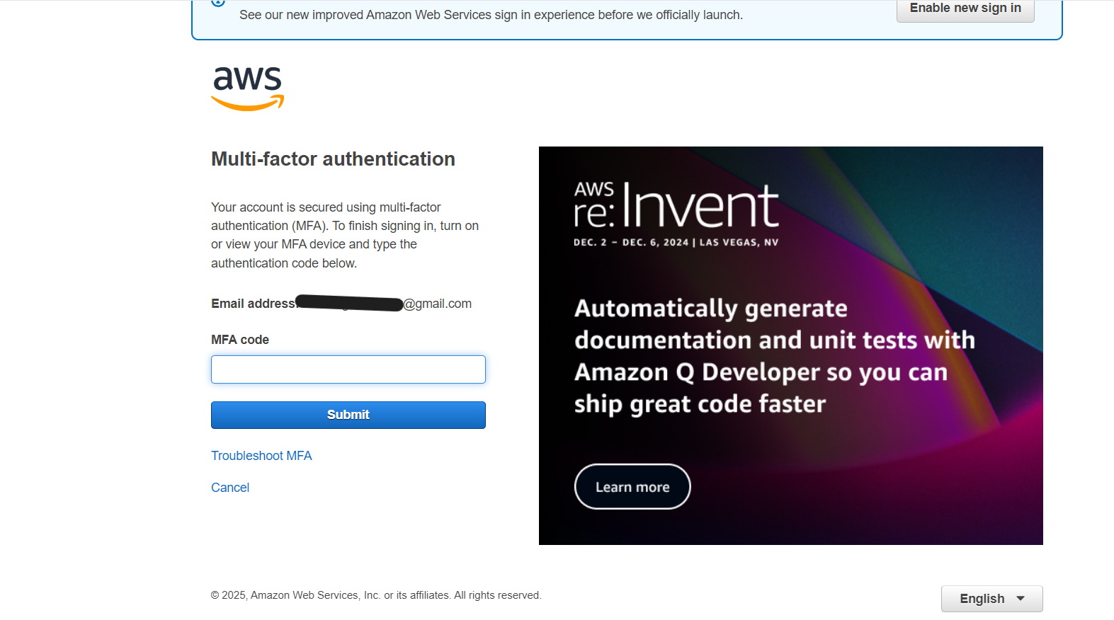
Sign in using root email or
create AWS Account
Complete MFA using authenticator app / hardware

Slide 4
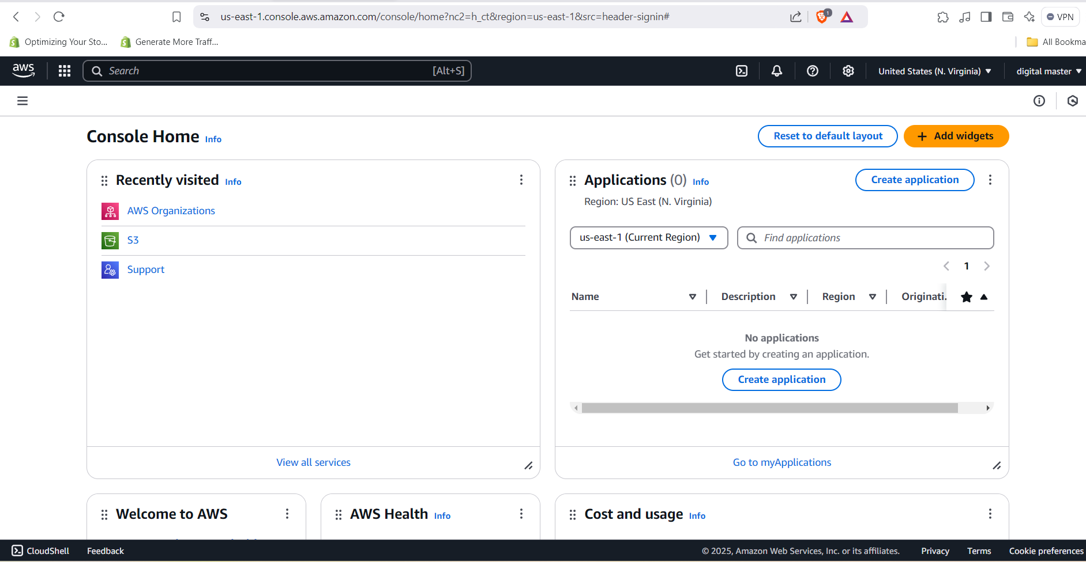
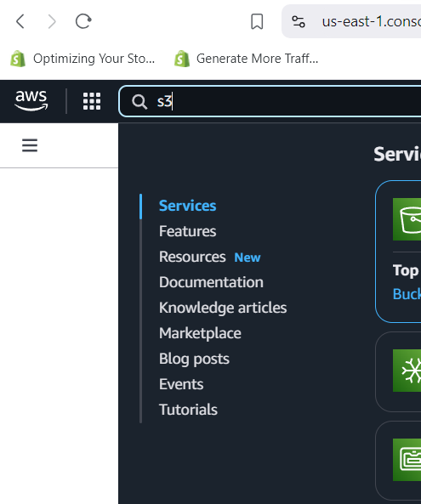
AWS management console is opened
Search S3 in search bar & open it.

Slide 5
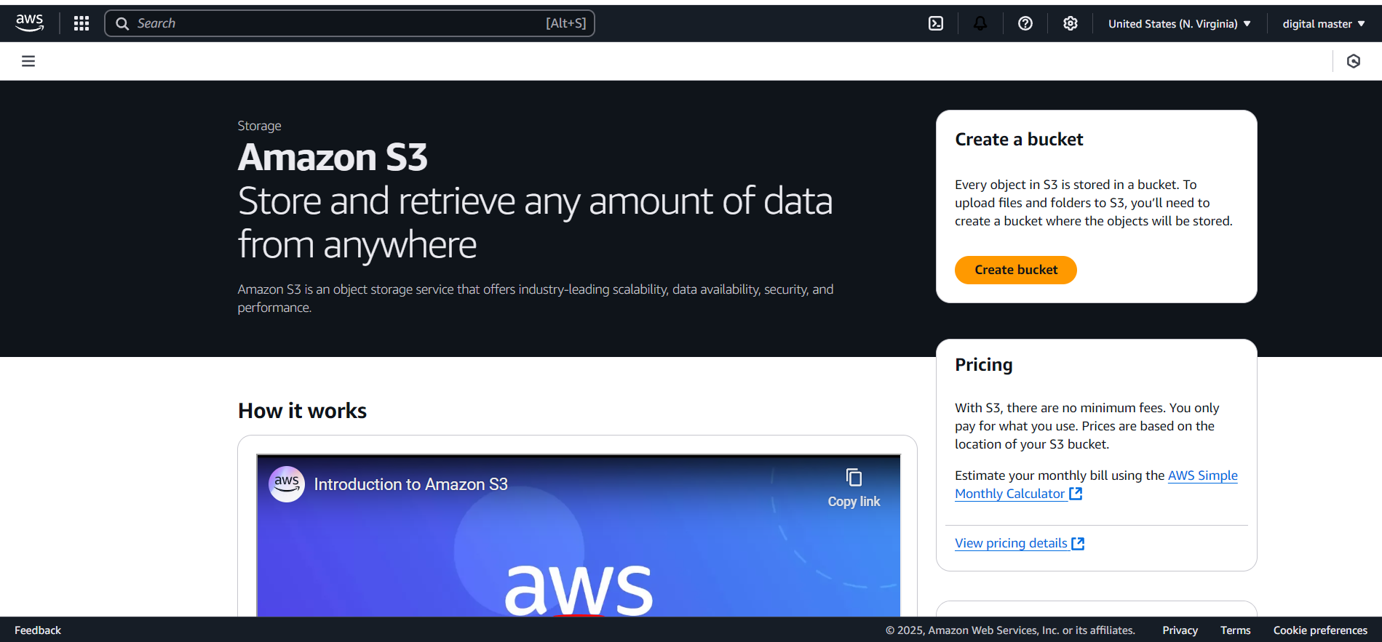
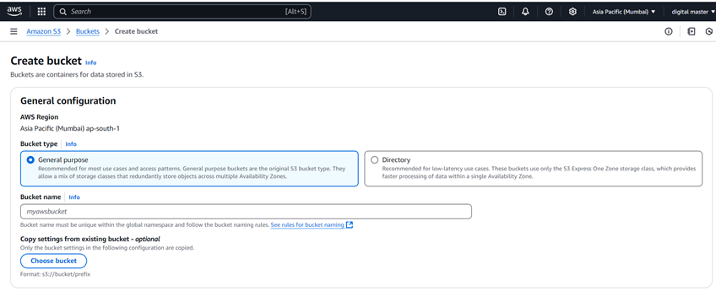
Click on “Create a bucket”
Choose bucket type
Choose globally unique name of bucket

Slide 6

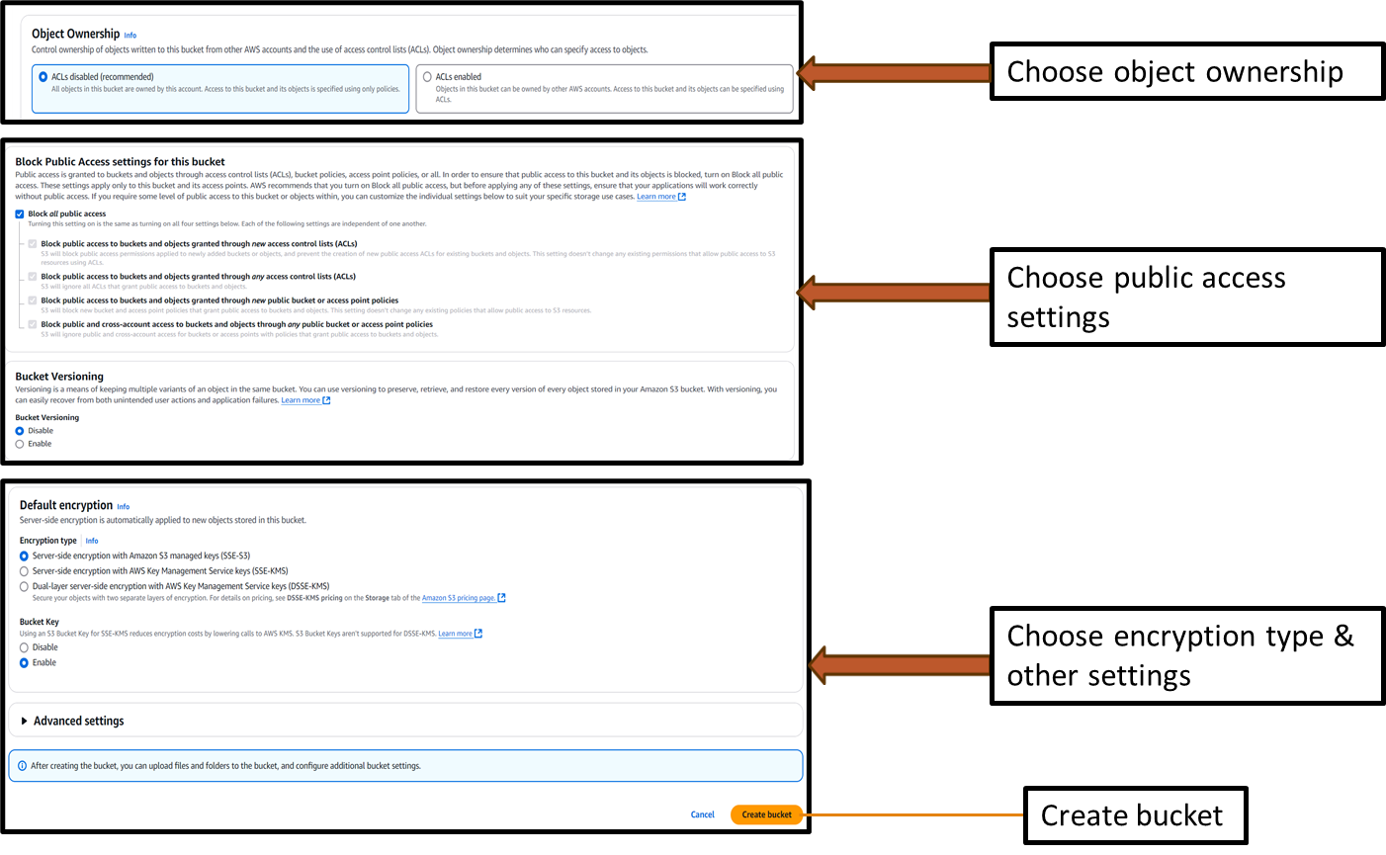

Slide 7
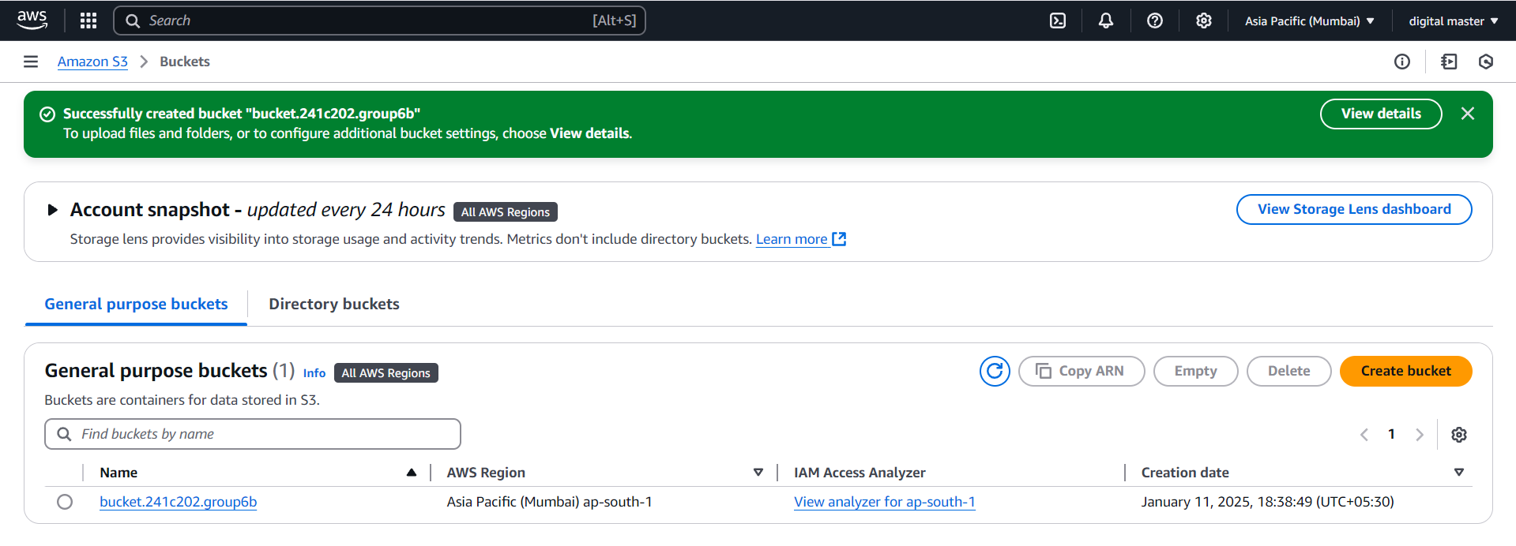
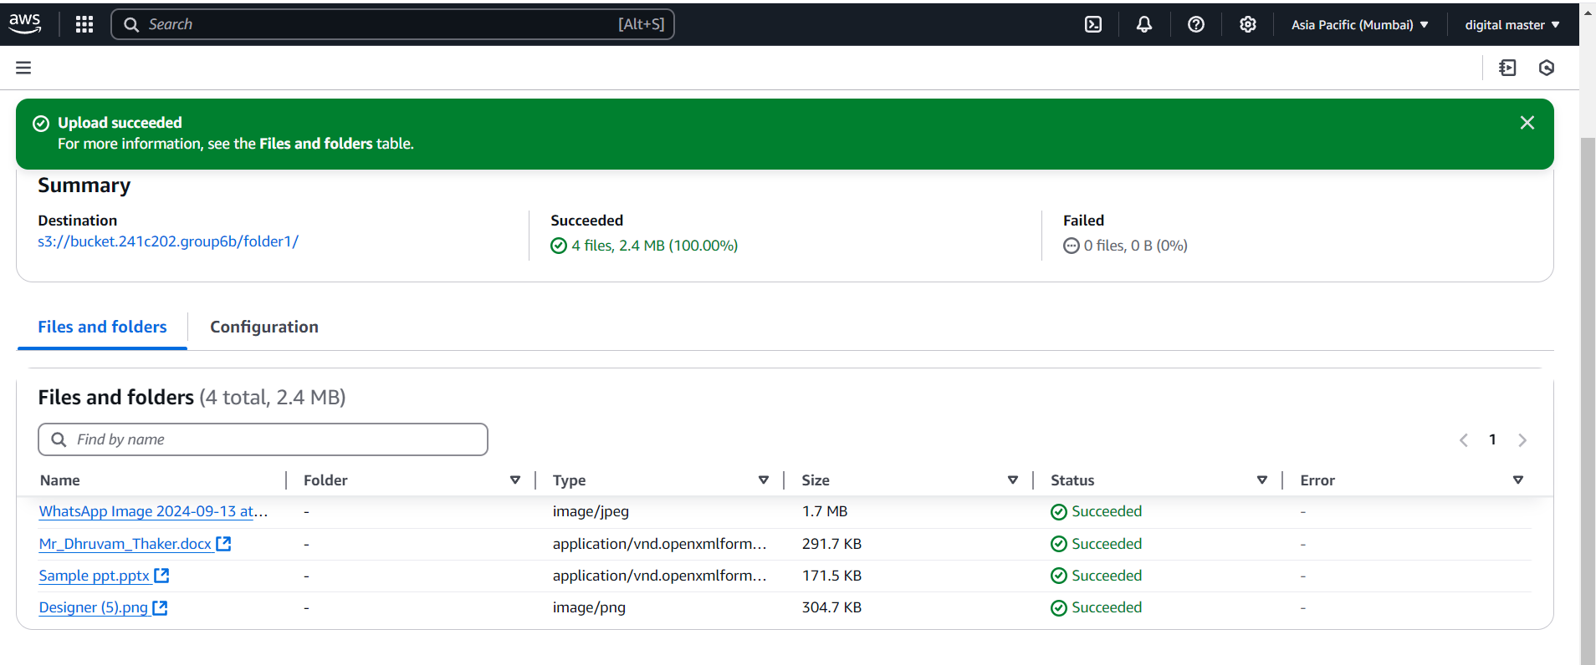
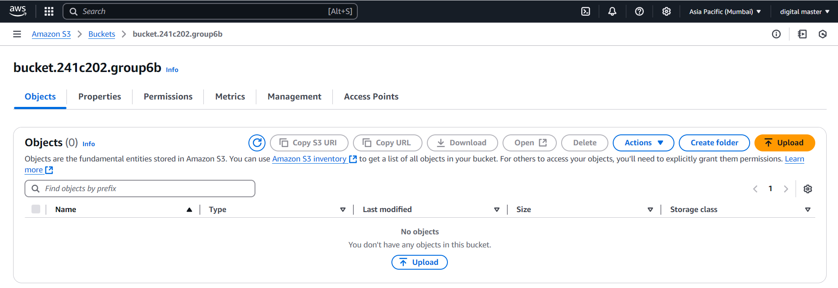
Bucket is created
We can access bucket from here
We can see here all uploaded files & folders
Upload files or folder to save in Cloud from upload button

Slide 8
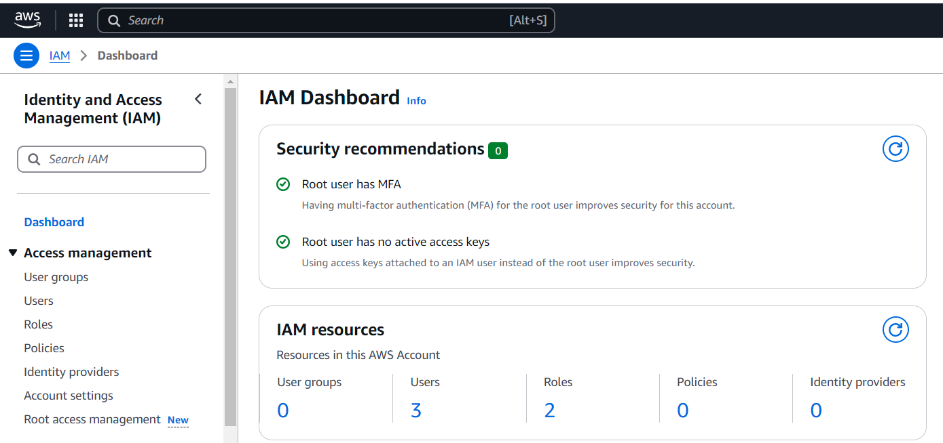
We can select users from here
Now we go to IAM dashboard, select users

Slide 9
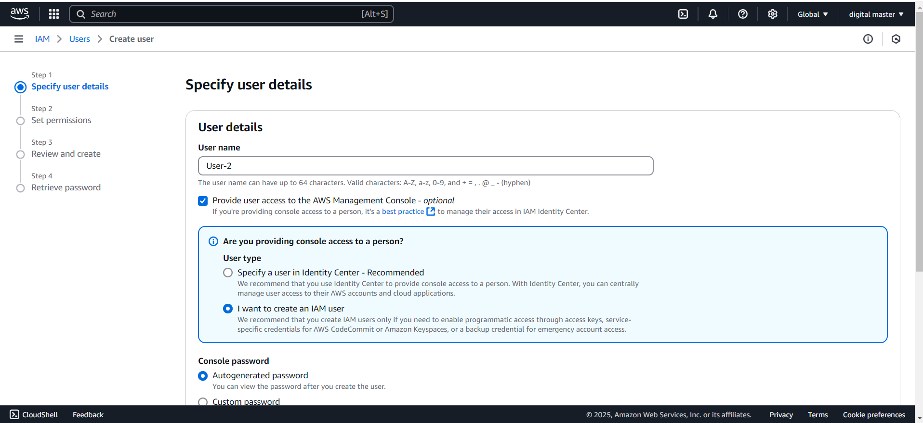
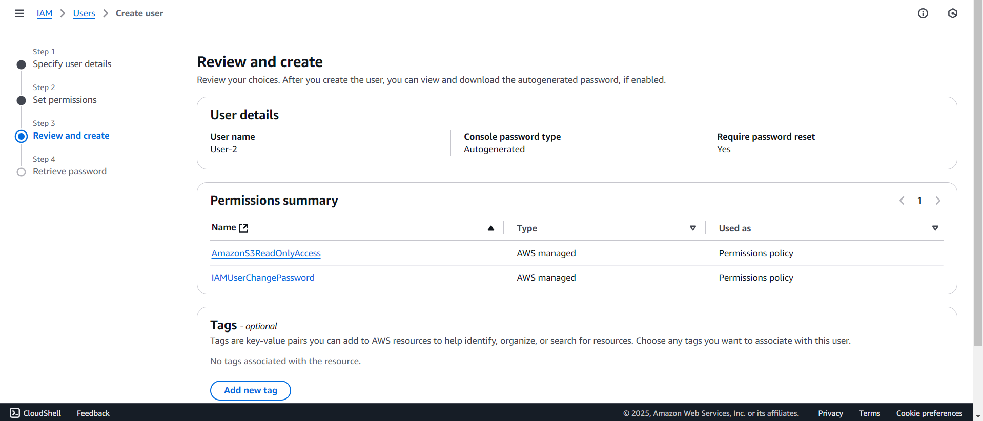
Review all details
Specify user details
i.e. user type & password

Slide 10
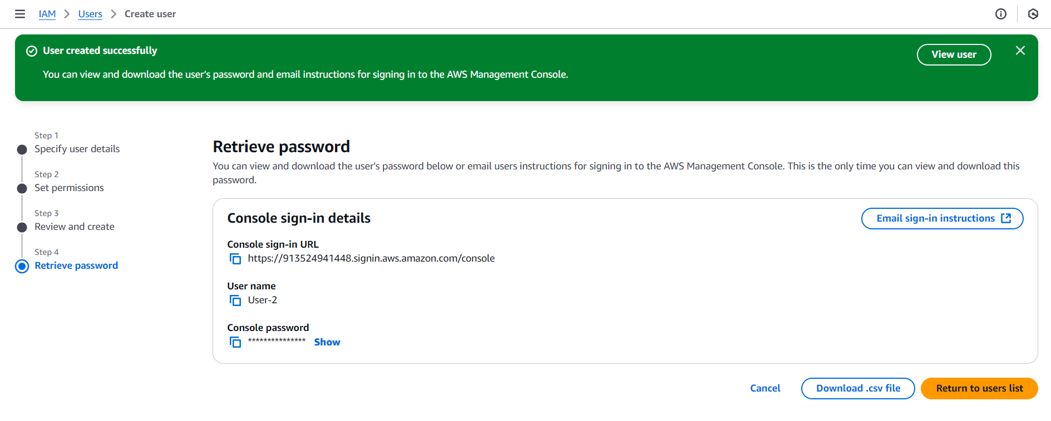
User is created
Download user credentials from here
By repeating this process we can create multiple users, we can also give them different roles in ‘Set permissions’.

Slide 11
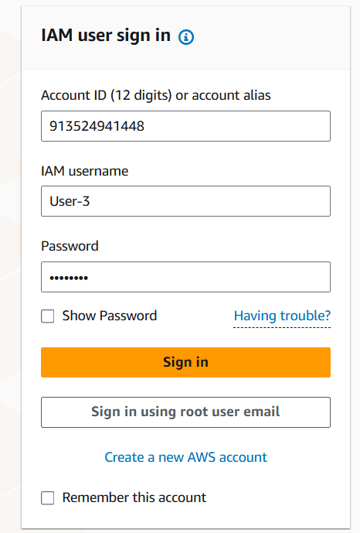
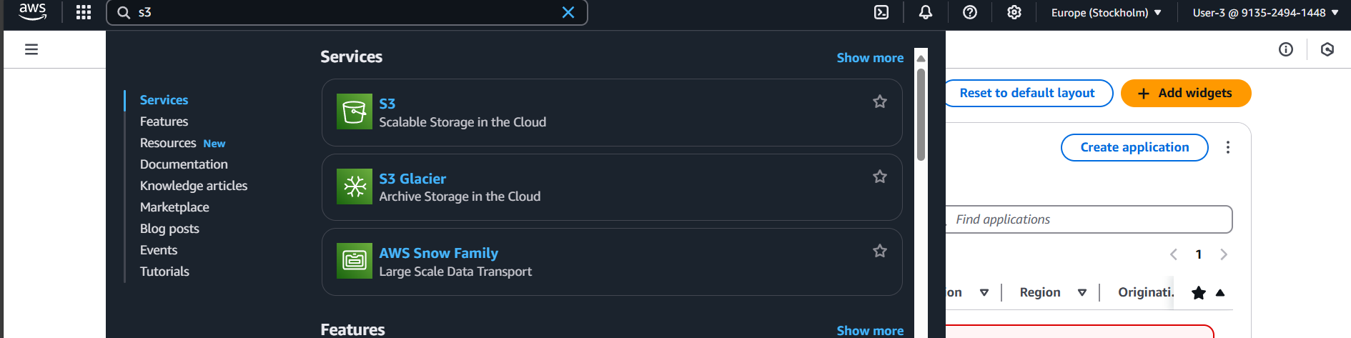
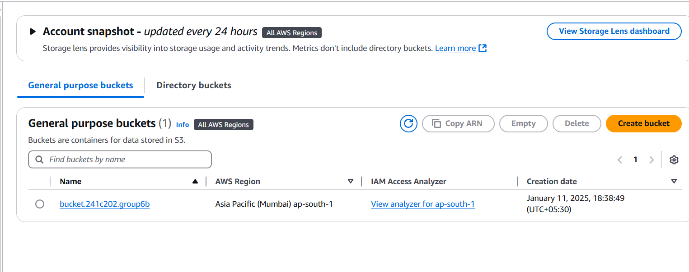
Go to s3 from search console
Sign in in an incognito window using user credentials
We can access bucket from here

Slide 12
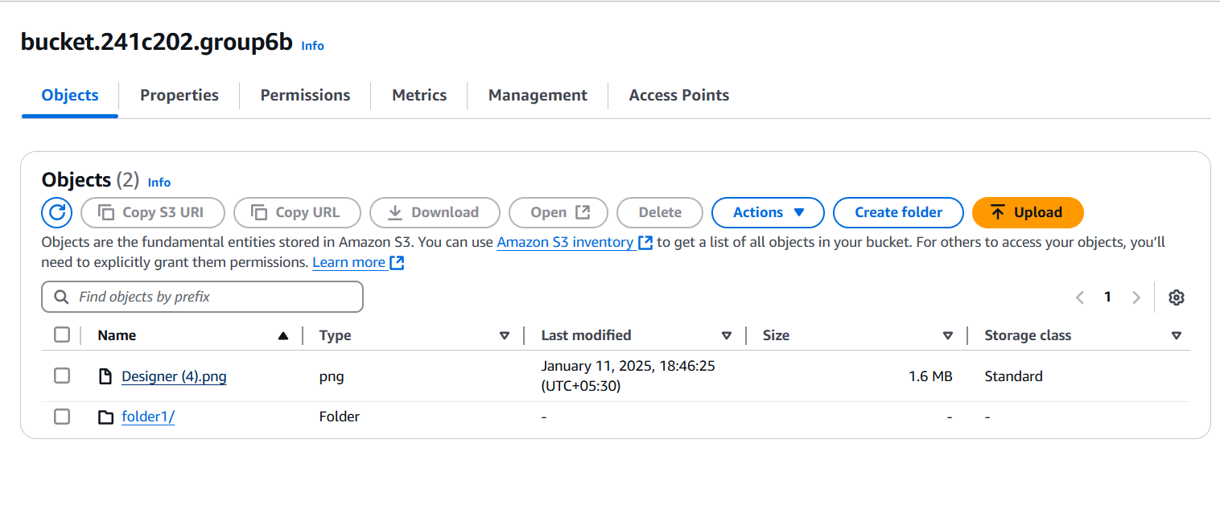
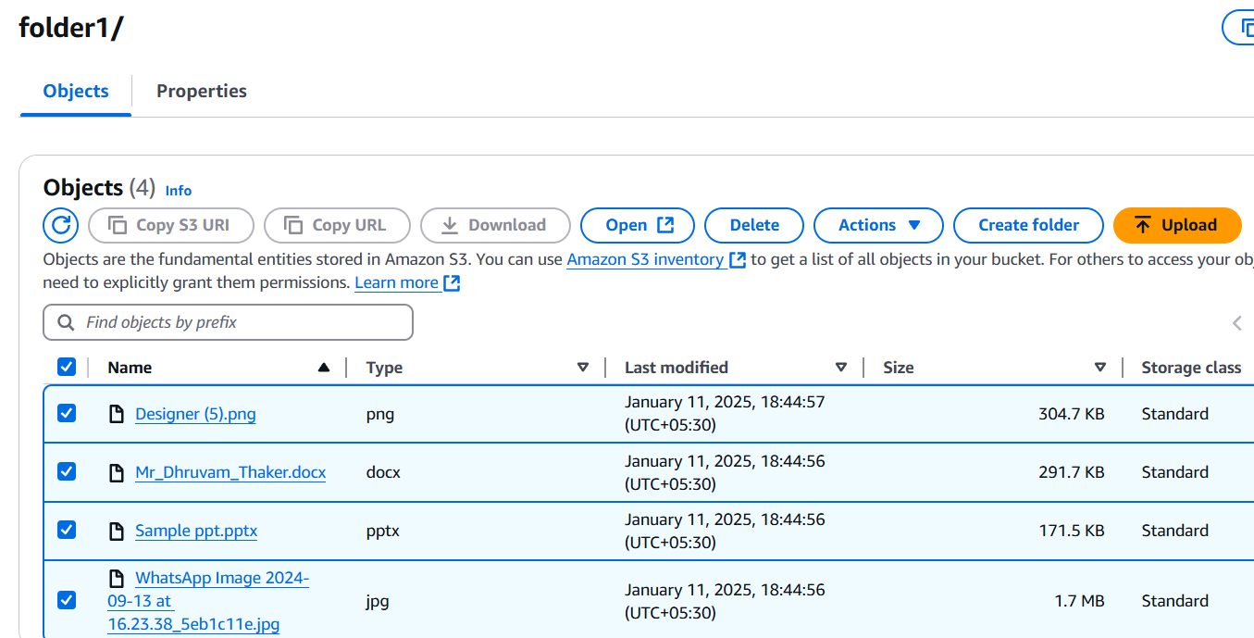
Here we can see all files in the bucket
we can see & perform different file actions like upload, open, delete etc.

Slide 13
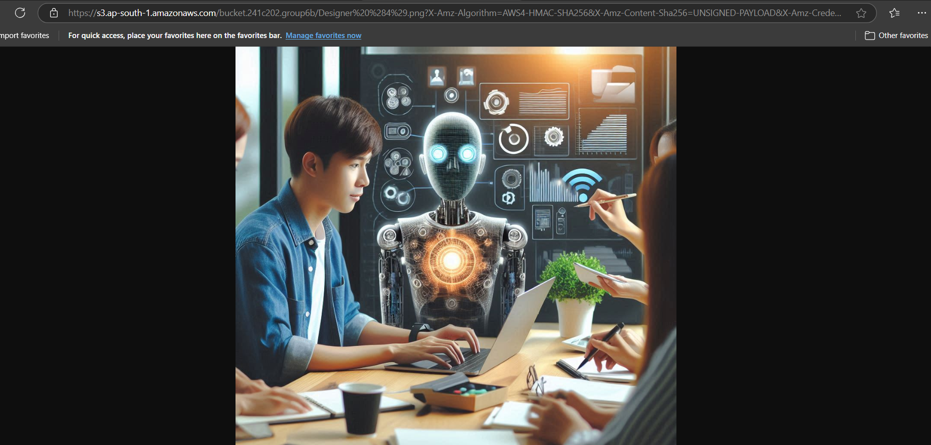
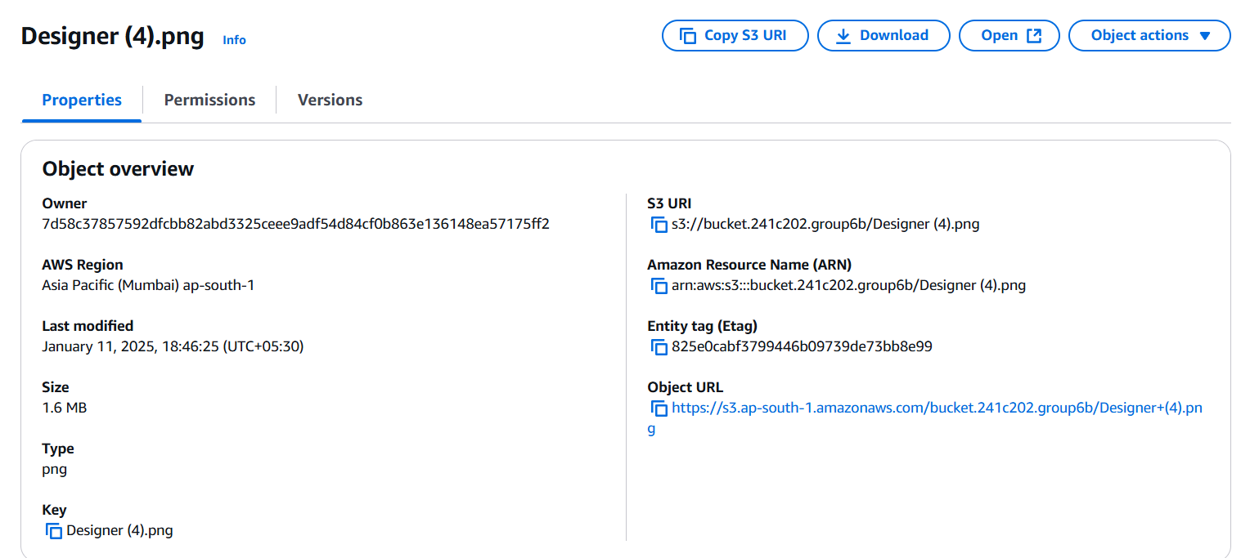
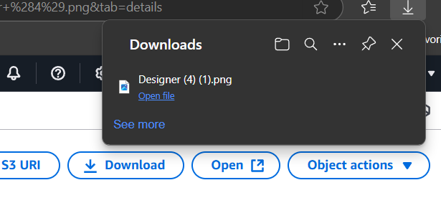
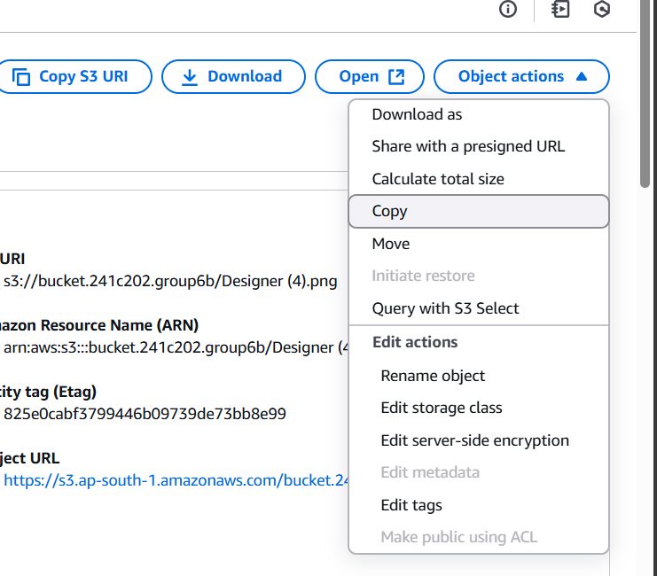
We can open and download this file from here
Even perform different object actions on it

Slide 14
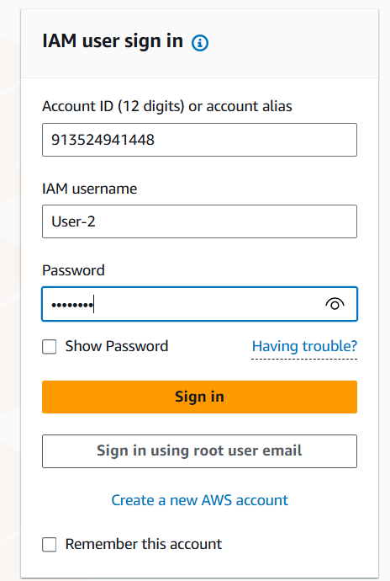
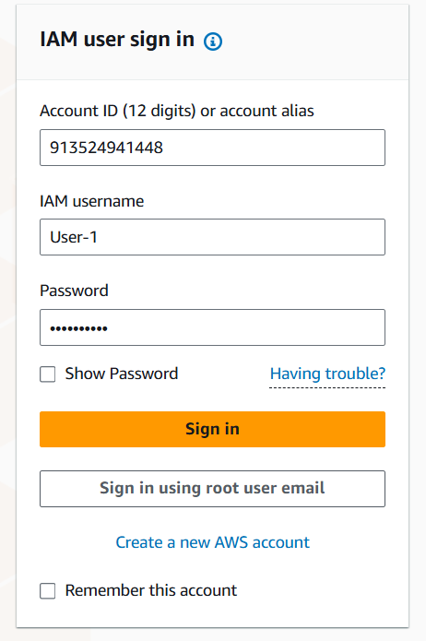
Different users will be able to access them according to access given to them
We can login with different user & perform different actions

Slide 15
Thank You

